Slide 1
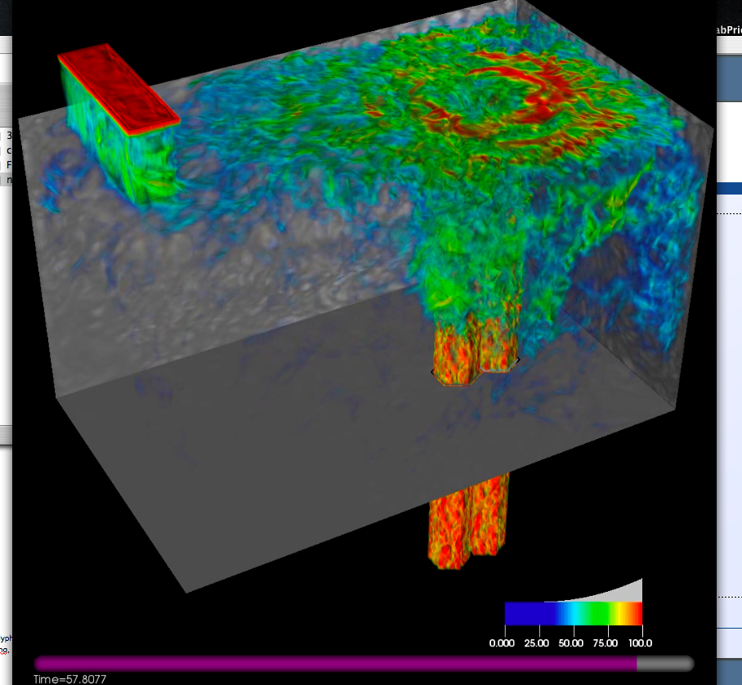
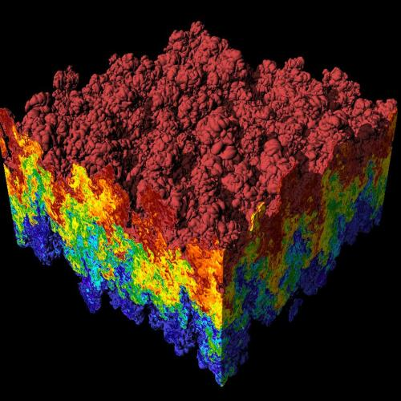
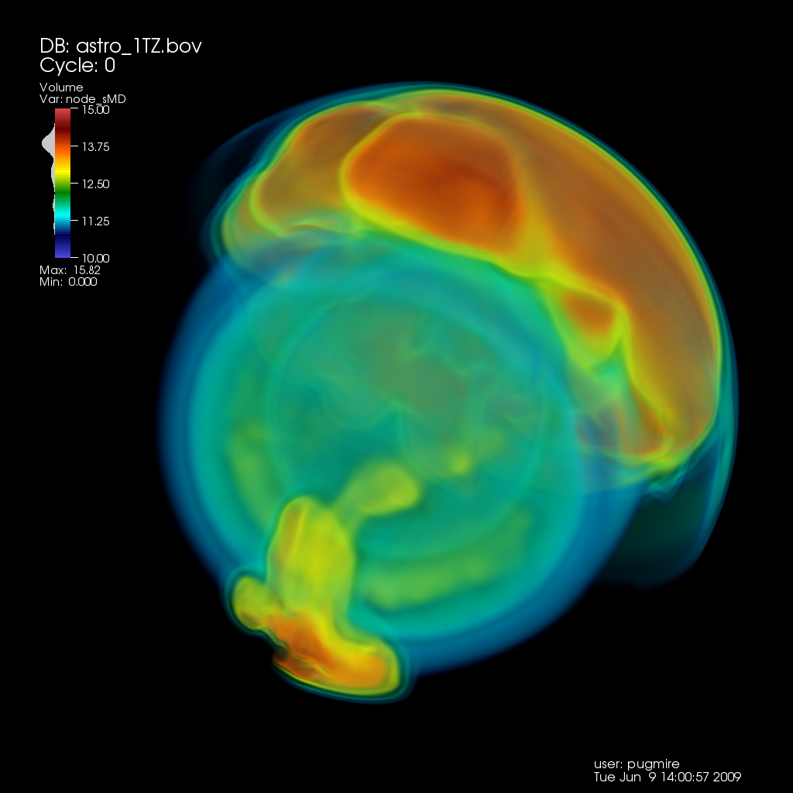
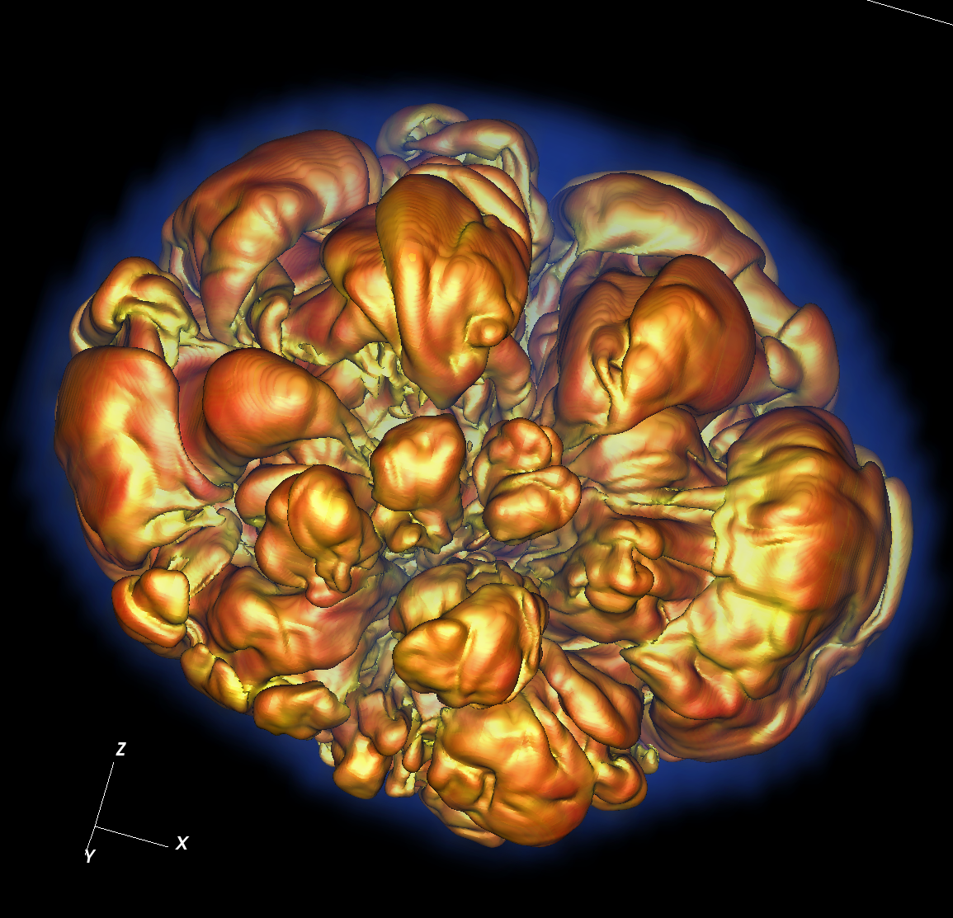
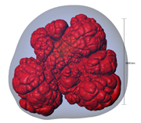
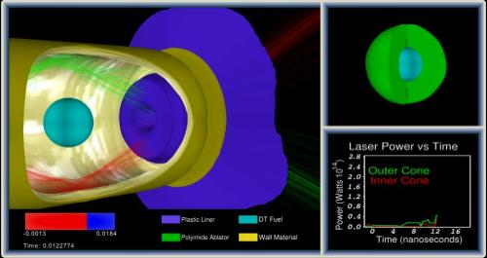
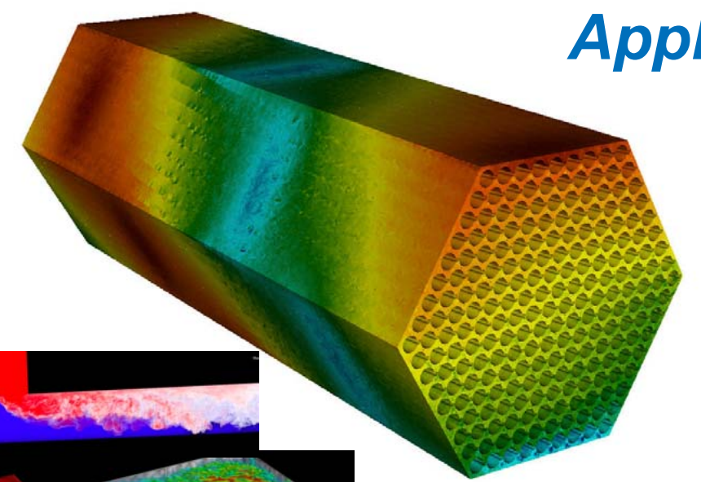
CIS 441/541: Intro to Computer Graphics Lecture 2: The Scanline Algorithm
January 10, 2019
Hank Childs, University of Oregon

Slide 2
Announcements

Slide 3
Trying to Add the Class?
Let’s talk after class…

Slide 4
Projects
1A due Saturday
1B: assigned today, due Monday
1C: assigned Tuesday, due following Wednesday (1/24)

Slide 5
Announcements
I am adding a 3rd late pass
Not everyone will be able to get 1B done by Monday
BUT: I really want you to try, since I want to be able to offer you lots of OH support

Slide 6
Office Hours
Hank
Thursday 5pm (help with 1A)
Friday: ??? (help with 1A)
Sunday: 3pm-430pm (help with 1B)
Monday: ??? (help with 1B)
Roscoe

Slide 7
Project 1A

Slide 8
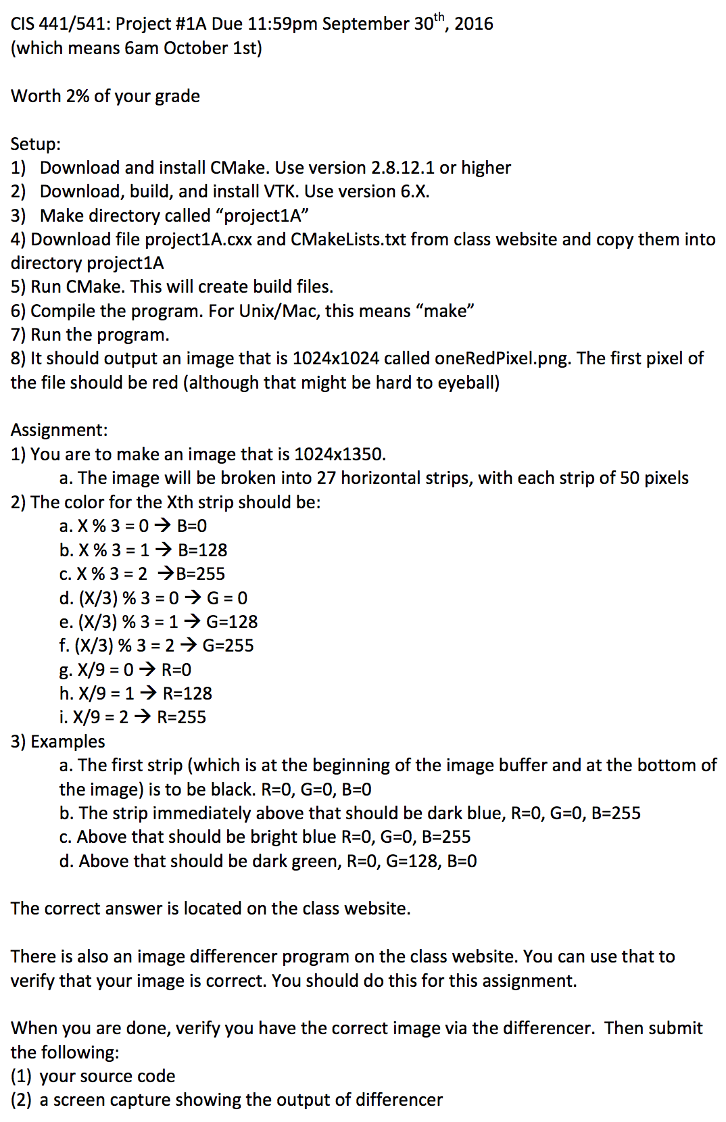
Project #1A
Goal: write a specific image
Due: Sat Jan 12th
% of grade: 2%
May be a little painful

Slide 9
Project #1A: background
Definitions:
Image: 2D array of pixels
Pixel: A minute area of illumination on a display screen, one of many from which an image is composed.
Pixels are made up of three colors: Red, Green, Blue (RGB)
Amount of each color scored from 0 to 1
100% Red + 100% Green + 0% Blue = Yellow
100% Red + 0% Green + 100 %Blue = Purple
0% Red + 100% Green + 0% Blue = Cyan
100% Red + 100% Blue + 100% Green = White

Slide 10
Project #1A: background
Colors are 0->1, but how much resolution is needed? How many bits should you use to represent the color?
Can your eye tell the difference between 8 bits and 32 bits?
→ No. Human eye can distinguish ~10M colors.
8bits * 3 colors = 24 bits = ~16M colors.
Red = (255,0,0)
Green = (0,255,0)
Blue = (0,0,255)

Slide 11
Project #1A: background
An “M by N” 8 bit image consists of MxNx3 bytes.
It is stored as:
P0/R, P0/G, P0/B, P1/R, P1/G, P1/B, … P(MxN)/R, P(MxN)/G, P(MxN)/B
P0 is the top, left pixel
P(M-1) is the top, right pixel
P((MxN)-M+1) is the bottom, left pixel
P(MxN) is the bottom, right pixel

Slide 12
Project #1A: background
The red contributions are called the “red channel”.
Ditto blue & green.
There are 3 channels in the image described above.
There is sometimes a fourth channel, called “alpha”
It is used for transparency.
→ Images are either RGB or RGBA

Slide 13
Project #1A in a nutshell
Assignment:
Install CMake
Install VTK
Modify template program to output specific image

Slide 14

What is ?
Cmake is a cross-platform, open-source build system.
CMake is a family of tools designed to build, test and package software.
CMake is used to control the software compilation process using simple platform and compiler independent configuration files.
CMake generates native makefiles and workspaces that can be used in the compiler environment of your choice.

Slide 15
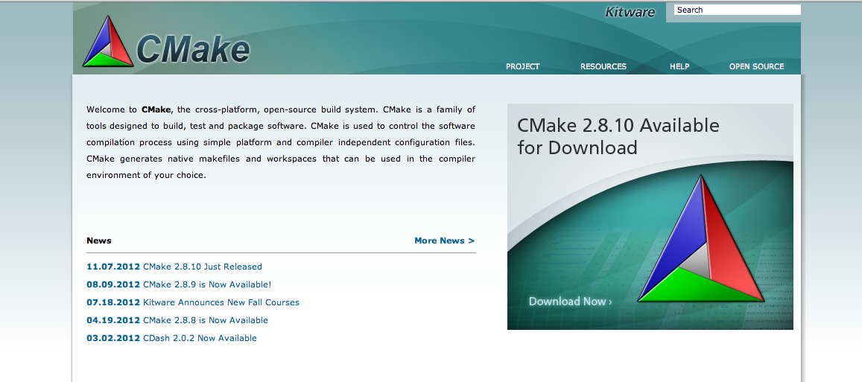
How do you install CMake?
Go to www.cmake.org & follow the directions

Slide 16

What is the ?
The Visualization Toolkit (VTK) is an open-source, freely available software system for 3D computer graphics, image processing and visualization.
VTK consists of a C++ class library and several interpreted interface layers including Tcl/Tk, Java, and Python.
VTK is cross-platform and runs on Linux, Windows, Mac and Unix platforms.

Slide 17
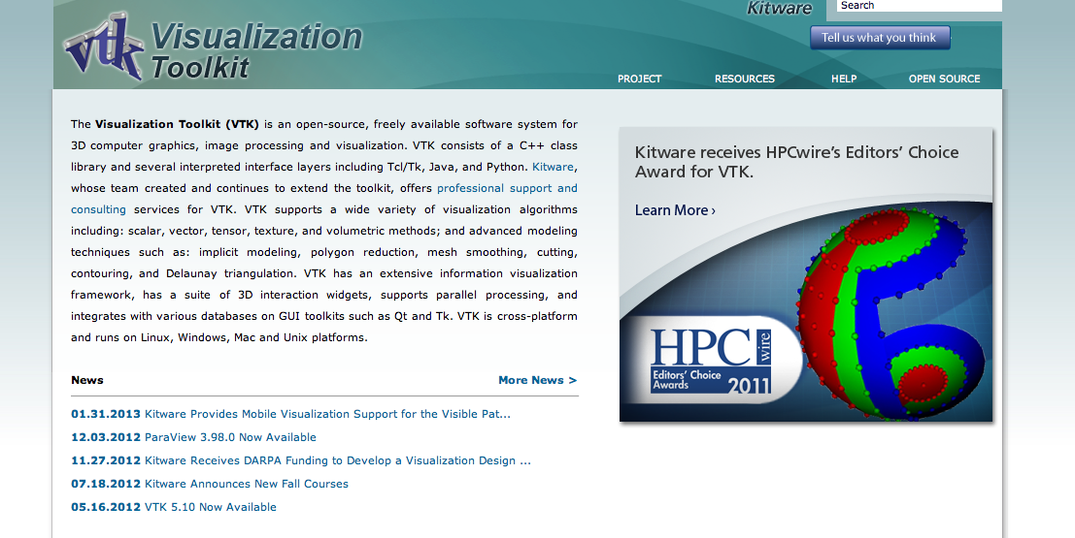
How do you install VTK?
Go to www.vtk.org , go to Resources->Download and follow the directions

Slide 18
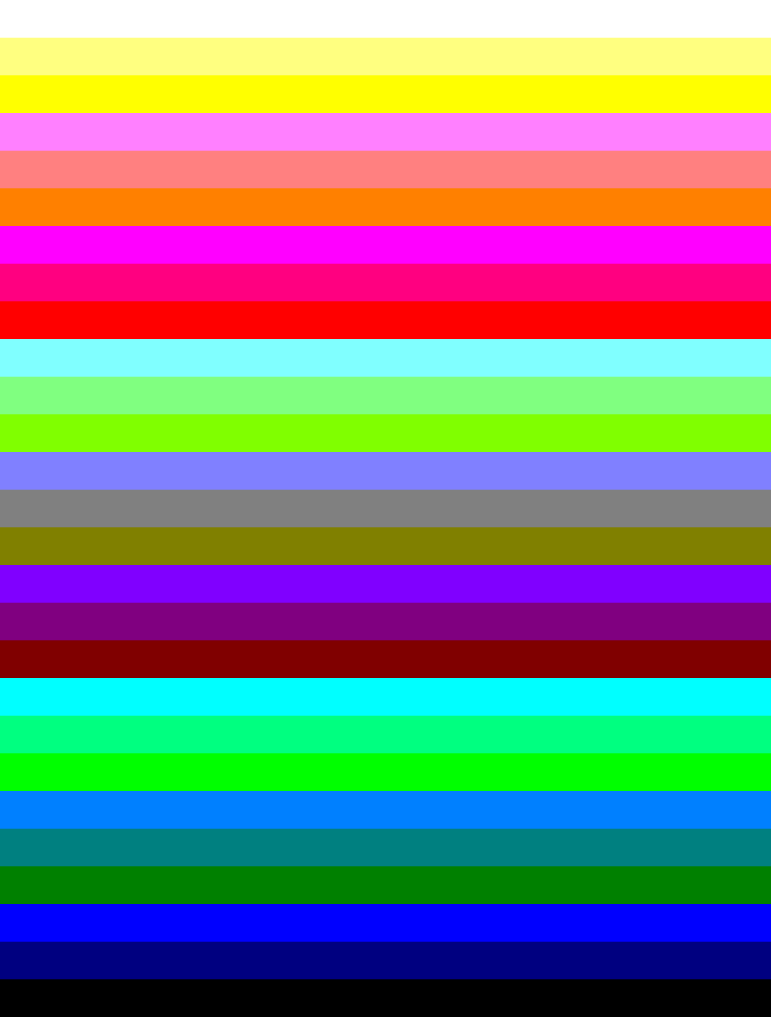
What is the image I’m supposed to make?
(255,255,255)
R=255
(255, 0, 0)
(128,255,255)
R=128
(128,0,128)
(128, 0, 0)
(0,255,255)
(0, 255, 128)
(0, 255, 0)
(0,128,255)
R=0
(0,128,128)
(0,128,0)
(0,0,255)
(0,0,128)
(0,0,0)

Slide 19
What do I do again?
Install CMake & VTK.
Download “project1A.cxx” from class website
Download “CMakeLists.txt” from class website
Run CMake
Modify project1A.cxx to complete the assignment
And…
Submit to Canvas the source and image result by Friday midnight.

Slide 20
Computer Graphics Models
Usually made up of triangles
+ tricks for shading
Picture credit: wikipedia, cs.mun.ca

Slide 21
The Scanline Algorithm

Slide 22
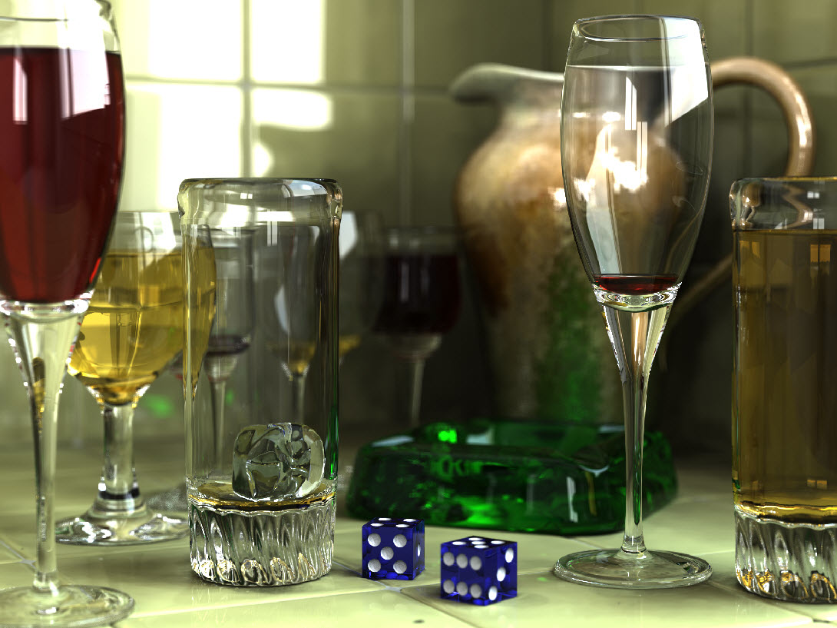
Reminder: ray-tracing vs rasterization
Two basic ideas for rendering: rasterization and ray-tracing
Ray-tracing: cast a ray for every pixel and see what geometry it intersects.
O(nPixels)
(actually, additional computational
complexity for geometry searches)
Allows for beautiful rendering
effects (reflections, etc)
Will discuss at the end of
the quarter
Notes:
Rasterization is faster and ray-tracing is for lower speed but higher quality.

Slide 23
Reminder: ray-tracing vs rasterization
Two basic ideas for rendering: rasterization and ray-tracing
Rasterization: examine every triangle and see what pixels it covers.
O(nTriangles)
(actually, additional computational complexity for painting in pixels)
GPUs do rasterization very quickly
Our focus for the next 5 weeks

Slide 24
What color should we choose for each of these four pixels?

Slide 25
What color should we choose for each of these four pixels?
Most dominant triangle

Slide 26
What color should we choose for each of these four pixels?
Average

Slide 27
What color should we choose for each of these four pixels?
Pixel center

Slide 28
What color should we choose for each of these four pixels?
Lower left of pixel

Slide 29
The middle and lower-left variants are half-pixel translations of the other
We will use the lower-left convention for the projects.
Pixel center
Lower left of pixel

Slide 30
Where we are…
We haven’t talked about how to get triangles in position.
Arbitrary camera positions through linear algebra
We haven’t talked about shading
Today, we are tackling this problem:
How to deposit triangle colors onto an image?

Slide 31
Problem: how to deposit triangle colors onto an image?
Let’s take an example:
12x12 image
Red triangle
Vertex 1: (2.5, 1.5)
Vertex 2: (2.5, 10.5)
Vertex 3: (10.5, 1.5)
Vertex coordinates are with respect to pixel locations

Slide 32
(0,12)
(12,12)
(2.5,10.5)
(2.5,1.5)
(10.8,1.5)
(0,0)
(12,0)

Slide 33
Our desired output
How do we make this output? Efficiently?

Slide 34
Don’t need to consider any
Pixels outside these lines

Slide 35
Scanline algorithm: consider all rows that can possibly overlap
Don’t need to consider any
Pixels outside these lines

Slide 36
Scanline algorithm: consider all rows that can possibly overlap
We will extract a “scanline”, i.e. calculate the intersections for one row of pixels
Don’t need to consider any
Pixels outside these lines
X
X
X
X
X
Y=5
Notes:
The range of scanline take the floor of top line and celling of the bottom line.

Slide 37
Red triangle
Vertex 1: (2.5, 1.5)
Vertex 2: (2.5, 10.5)
Vertex 3: (10.5, 1.5)

Slide 38
Red triangle
Vertex 1: (2.5, 1.5)
Vertex 2: (2.5, 10.5)
Vertex 3: (10.5, 1.5)
Y=5

Slide 39
Red triangle
Vertex 1: (2.5, 1.5)
Vertex 2: (2.5, 10.5)
Vertex 3: (10.5, 1.5)
Y=5
What are the end points?

Slide 40
Red triangle
Vertex 1: (2.5, 1.5)
Vertex 2: (2.5, 10.5)
Vertex 3: (10.5, 1.5)
Y=5
(2.5, 5)
What are the end points?

Slide 41
Red triangle
Vertex 1: (2.5, 1.5)
Vertex 2: (2.5, 10.5)
Vertex 3: (10.5, 1.5)
Algebra!
Y=5
(2.5, 5)
What are the end points?

Slide 42
Red triangle
Vertex 1: (2.5, 1.5)
Vertex 2: (2.5, 10.5)
Vertex 3: (10.5, 1.5)
Y = mx+b
10.5=m*2.5+b
1.5 = m*10.5+b
→
9 = -8m
m = -1.125
b = 13.3125
5 = -1.125*x + 13.3125
x = 7.3888
Algebra!
Y=5
(2.5, 5)
What are the end points?

Slide 43
Scanline algorithm: consider all rows that can possibly overlap
Don’t need to consider any
Pixels outside these lines
2.5
X
X
X
X
X
7.3888
Y=5

Slide 44
Scanline algorithm: consider all rows that can possibly overlap
(2.5, 1.5)
0
1
2
3
Don’t need to consider any
Pixels outside these lines
4
2.5
X
X
X
X
X
7.3888
Y=5
6
7
(2.5, 10.5)
8
Color is deposited at (3,5), (4,5), (5,5), (6,5), (7,5)
Notes:
Floor of the top, right;
ceiling of bottom, left
Vertex 1: (2.5, 1.5)
Vertex 2: (2.5, 10.5)
Vertex 3: (10.5, 1.5)

Slide 45
Scanline algorithm
Determine rows of pixels triangles can possibly intersect
Call them rowMin to rowMax
rowMin: ceiling of smallest Y value
rowMax: floor of biggest Y value
For r in [rowMin → rowMax] ; do
Find end points of r intersected with triangle
Call them leftEnd and rightEnd
For c in [ceiling(leftEnd) → floor(rightEnd) ] ; do
ImageColor(r, c) ← triangle color

Slide 46
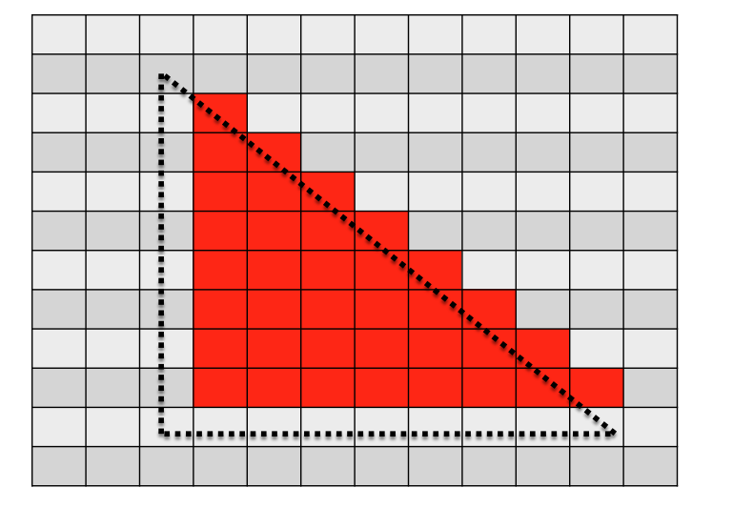
Scanline algorithm
Determine rows of pixels triangles can possibly intersect
For r in [rowMin → rowMax] ; do
Find end points of r intersected with triangle
Call them leftEnd and rightEnd
For c in [ceiling(leftEnd) → floor(rightEnd) ] ; do
ImageColor(r, c) ← triangle color
Y values from 1.5 to 10.5
mean rows 2 through 10
For r = 5, leftEnd = 2.5,
rightEnd = 7.3888
For r = 5, we call ImageColor with
(5,3), (5,4), (5,5), (5,6), (5,7)

Slide 47
Arbitrary Triangles
The description of the scanline algorithm in the preceding slides is general.
But the implementation for these three triangles vary:
Notes:
3 points, sort by the x of these points, if the l
Write the algo for the first two, and find the algo to split the top and bottom of the third.

Slide 48
Supersamping: use the scanline algorithm a bunch of times to converge on the “average” picture.

Slide 49
Where we are…
We haven’t talked about how to get triangles into position.
Arbitrary camera positions through linear algebra
We haven’t talked about shading
Today, we tackled this problem:
How to deposit triangle colors onto an image?
Still don’t know how to:
Vary colors (easy)
Deal with triangles that overlap

Slide 50
Project 1B

Slide 51
Arbitrary Triangles
You will implement the scanline algorithm for “going down” triangles

Slide 52
Project #1B
Goal: apply the scanline algorithm to “going down” triangles and output an image.
File “project1B.cxx” has triangles defined in it.
Due: Monday, Jan 14th
% of grade: 3%

Slide 53
Project #1C
You will implement the scanline algorithm for arbitrary triangles … plan ahead

Slide 54
Tips On Floating Point Precision

Slide 55
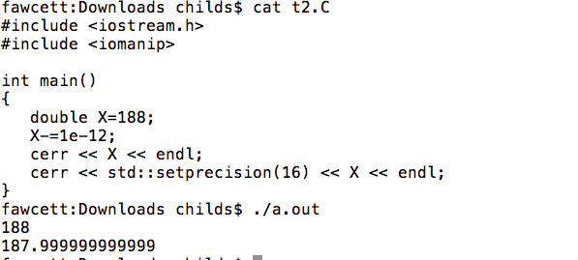
Project 1B
Cout/cerr can be misleading:

Slide 56
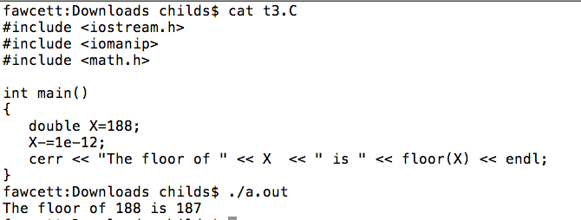
Project 1B
The limited accuracy of cerr/cout can cause other functions to be appear to be wrong:

Slide 57
Project 1B
Floating point precision is an approximation of the problem you are trying to solve
Tiny errors are introduced in nearly every operation you perform
Exceptions for integers and denominators that are a power of two
Fundamental problem:
Changing the sequence of these operations leads to *different* errors.
Example: (A+B)+C ≠ A+(B+C)

Slide 58
Project 1B
For project 1B, we are making a binary decision for each pixel: should it be colored or not?
Consider when a triangle vertex coincides with the bottom left of a pixel:
We all do different variations on how to solve for the endpoints of a line, so we all get slightly different errors.

Slide 59
Project 1B
Our algorithm incorporates floor and ceiling functions.
This is the right place to bypass the precision problem.
I have included “floor_441” and “ceil_441” in project prompt. You need to use them, or you will get one pixel differences.

Slide 60
Project 1B: other thoughts
You will be building on this project …
think about magic numbers (e.g. screen size of 1000)
add safeguards against cases that haven’t shown up yet
Assume nothing!

